Slide 1
2024 1st presentation
By Elvis Kimara

Slide 2
Achievements
Zaki
Had in depth discussions about ideas to implement moving forward
Explore using latent spaces of point clouds when “clustering/comparing” point clouds for sorting
When interpolating, return a T value, and train a model to find the T value by itself
Other ideas: isoMap, voxelization for resampling, principal component analysis

Slide 3
Achievements
Mozhgan
Shared her current research/ideas for different similarity metrics like L2
Might get specific plant point clouds from her
Arbab
Shared with me PointNet that is better for point cloud visualization

Slide 4
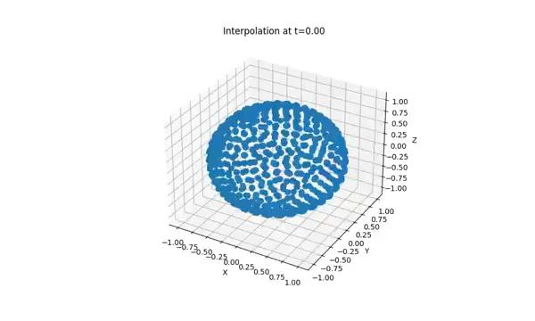
Achievements: Early work on interpolating without linear interpolation (using implicitly learned T)

Slide 5
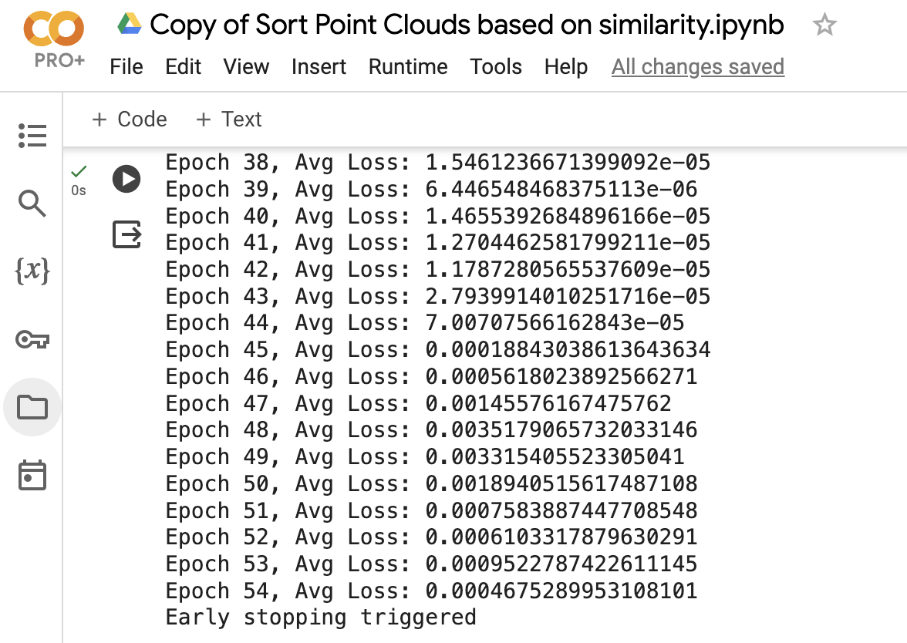
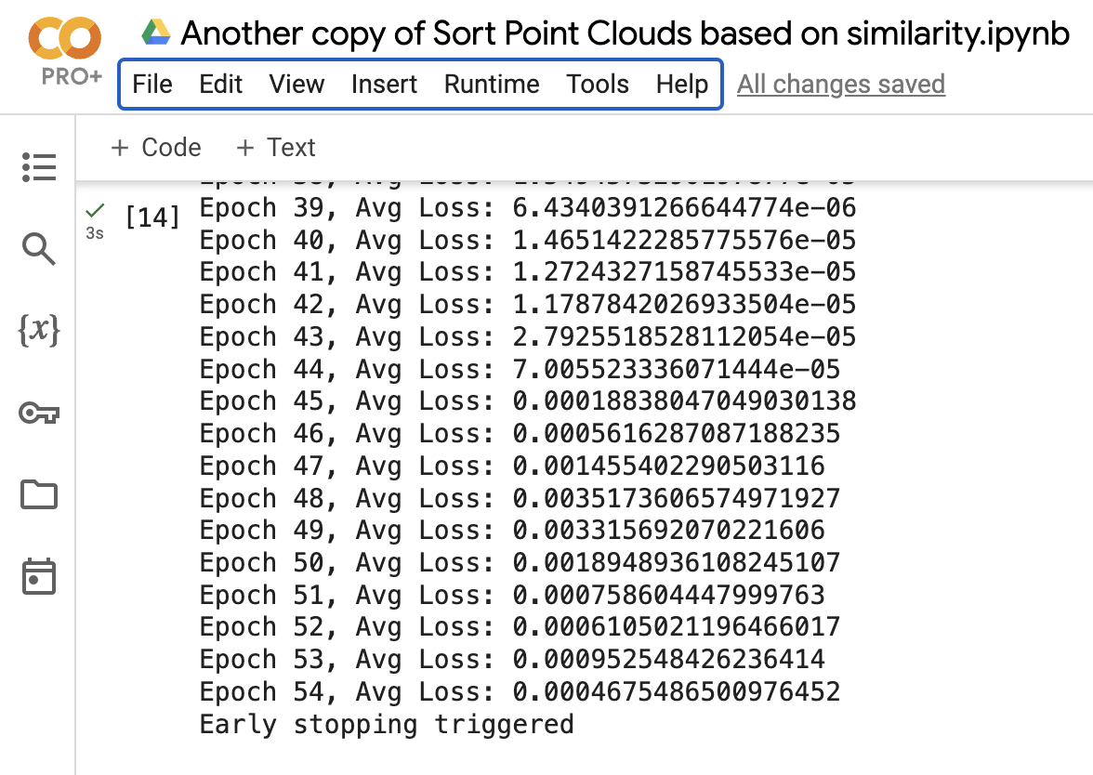

Slide 6
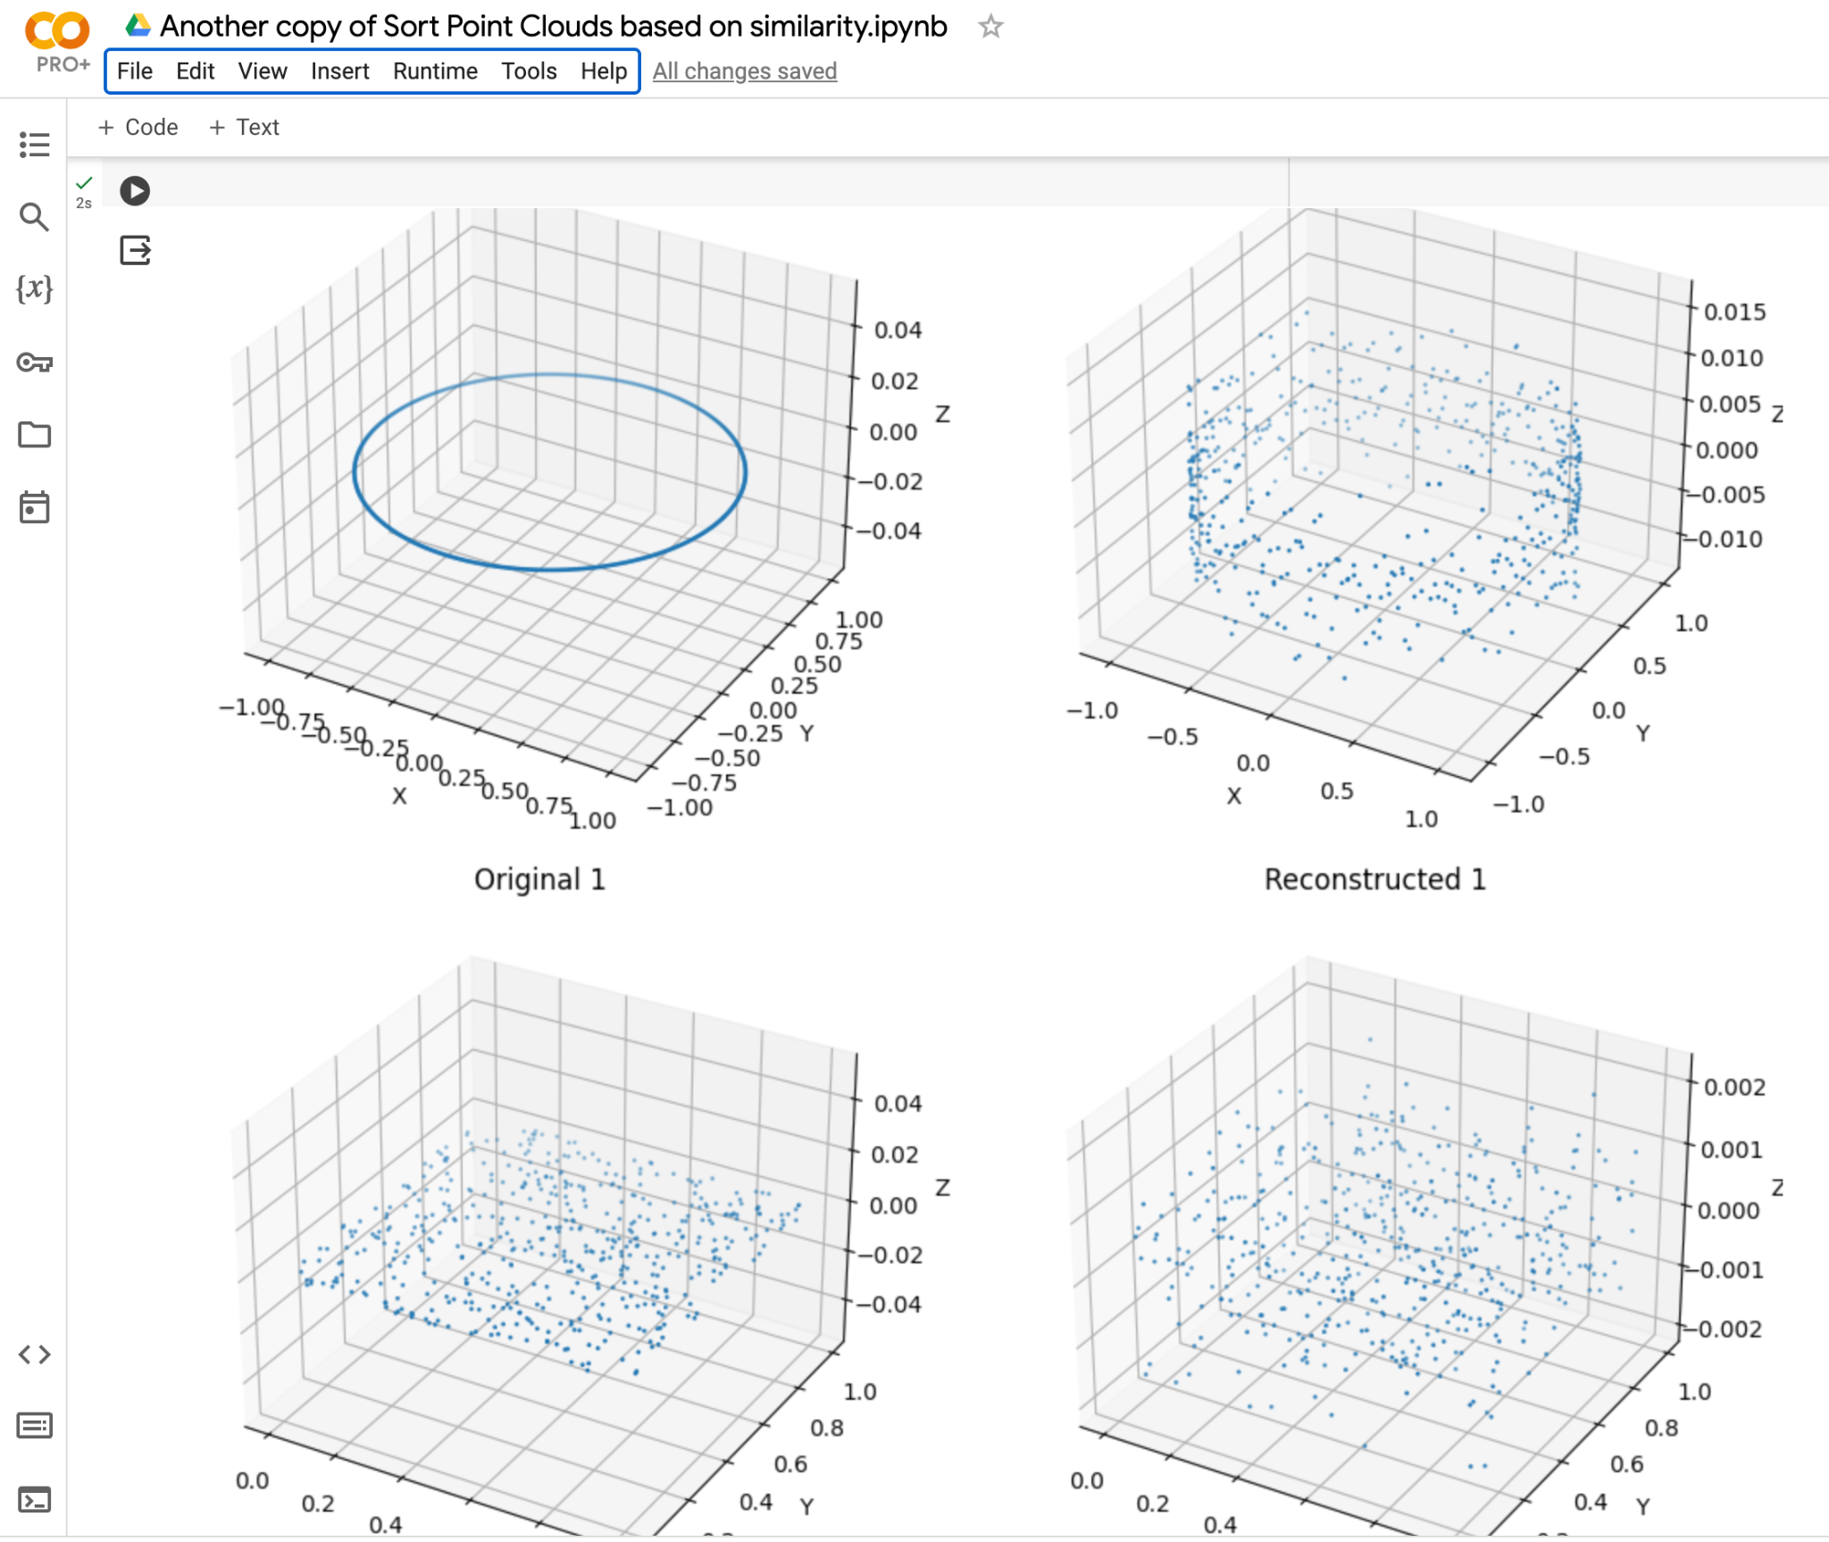
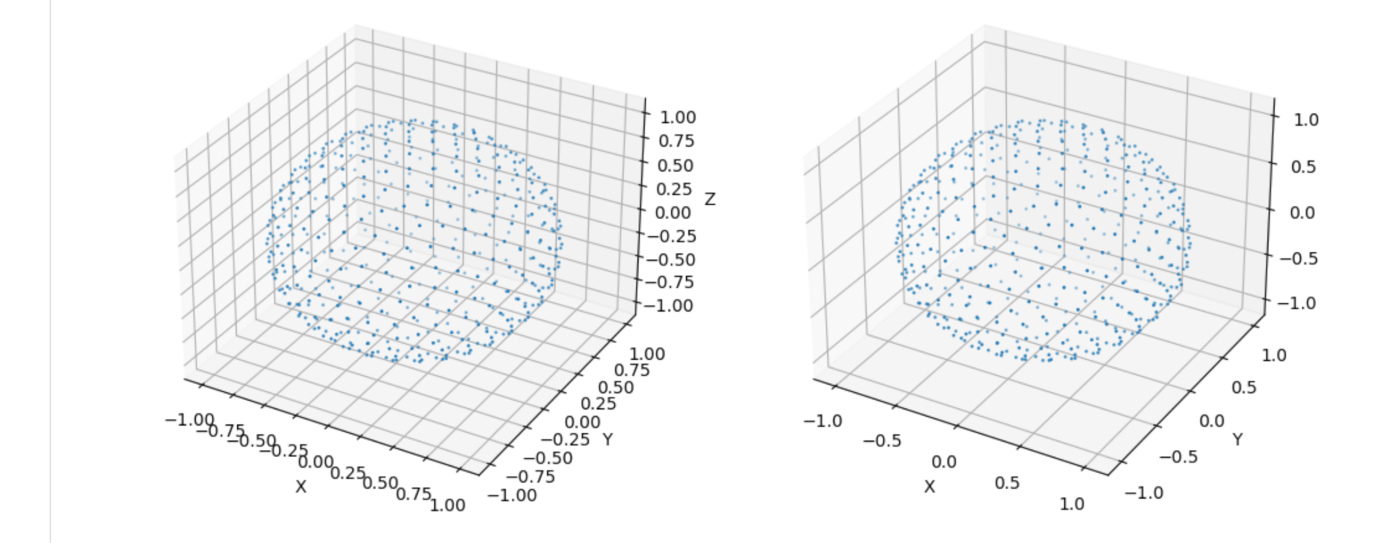

Slide 7
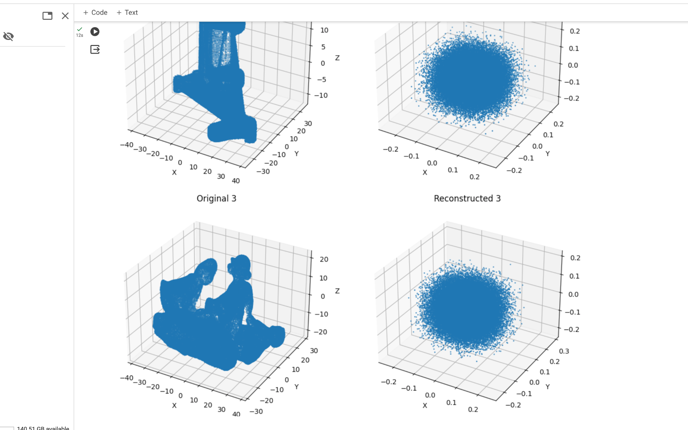

Slide 8
